Slide 1
Algorithms are reshaping the art of managing workers: what are the implications for occupational safety and health?
Algorithmic Management and Artificial Intelligence
ALMA-AI – PEROSH Webinar
27th January 2026
Maurizio Curtarelli
Prevention and Research Unit
European Agency for Safety and Health at Work (EU-OSHA)

Slide 2
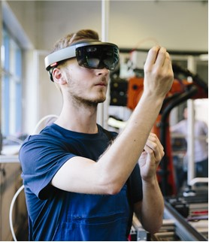
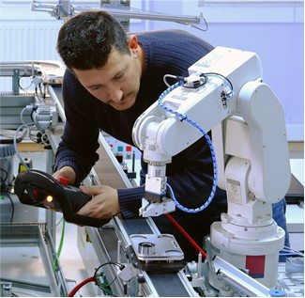
Digitalisation and occupational safety and health
OSH
Internet of things
Algorithms
Digital labour platforms
Artificial Intelligence
Wearables and “smart” devices
Collaborative robotics
Big data
© iStockphoto / fotografixx
© iStockphoto / rozdemir01
Digital technologies are rapidly changing how, where and when we work
For workers and employers in all sectors, digital technology offers increased opportunities but also presents challenges and risks in terms of safety and health
Notes:
LA DIGITALIZZAZIONE STA TRASFORMANDO IL MONDO DEL LAVORO E RICHIEDE SOLUZIONI NUOVE E AGGIORNATE IN MATERIA DI SALUTE E SICUREZZA SUL LAVORO.
L'EMERGERE DI TECNOLOGIE QUALI L'INTELLIGENZA ARTIFICIALE, I BIG DATA, LA ROBOTICA COLLABORATIVA, L'INTERNET DELLE COSE, GLI ALGORITMI, LE PIATTAFORME DI LAVORO DIGITALI E, AL TEMPO STESSO, UN IMPORTANTE AUMENTO DELLA POPOLAZIONE CHE LAVORA A DISTANZA COMPORTA OPPORTUNITÀ PER LAVORATORI E DATORI DI LAVORO, MA ANCHE NUOVE SFIDE E RISCHI PER LA SALUTE E SICUREZZA.

Slide 3
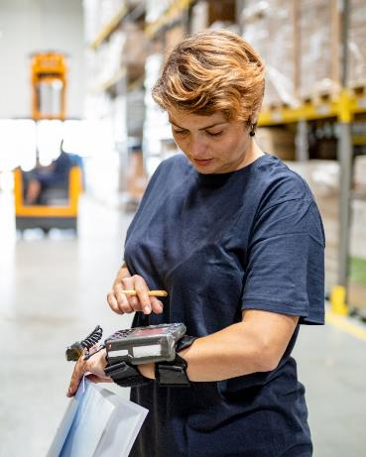
Worker management is as old as work is … BUT nowadays…
Digital technologies
Personal computers
Laptops & Mobile devices
Automated machineries digitally connected to companies’ software systems
GPS
Cameras
Wearable devices
Other sensory devices
In all jobs using digital technologies
Both in and outside the workplace
Large amount of
real-time data collected
Time spent per task
Content of calls or emails
Keyboard clicks
Screenshots
Websites visited
Social media
Movements
Locations
Worker ratings
Vital signs
Indicators of stress and fatigue
Micro-facial expressions
Tone of voice
Workplace
Etc.
Processed by AI / algorithms
To make automated or semi-automated decisions about the worker (directing, instructing, allocating work, penalizing, etc.)
Providing information to management diagnostic, prescriptive or predictive insight
Algorithmic management to improve:
Productivity and efficiency
Management of work (task allocation, shift scheduling, etc.)
Worker performance HR management, incl. performance appraisals, career development, talent management
Worker engagement
Health and safety monitoring, prevention and training
Worker well-being
© iStockphoto / zoranm
To assign tasks and work schedules to workers to ensure optimal labour coverage of work shifts.
To evaluate worker performance and productivity and provide recommendations on how it can be improved.

Slide 4
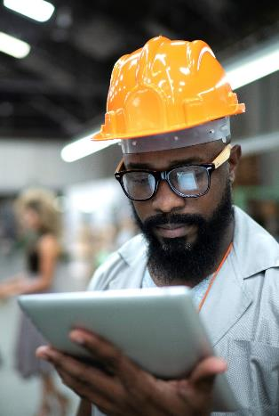
Facts and figures – uptake of AM systems
  Relatively low uptake but growing across the EU27
Mainly in larger companies
Mainly in jobs with manual/repetitive routine tasks
  Sharp increase in worker-monitoring software (COVID-19)
  Increased number of patents for AM technologies
© iStockphoto / FG Trade

Slide 5
ESENER survey (EU-27) - 2024
Use of digital technologies for algorithmic management
Base: all establishments.

Slide 6
Use of digital technologies for algorithmic management
EU-OSHA, OSH Pulse 2025
Workers reporting that their organisation uses digital technologies to:
Base: all respondents, EU27 (n=25 688)
Notes:
Source: EU-OSHA, ‘OSH Pulse – Occupational safety and health in post-pandemic workplaces’, 2022 (https://osha.europa.eu/en/facts-and-figures/osh-pulse-occupational-safety-and-health-post-pandemic-workplaces).
EU-OSHA commissioned the ‘Flash Eurobarometer – OSH Pulse’ survey with the aim of gaining insights into the state of occupational safety and health (OSH) in post-pandemic workplaces.
A representative sample of more than 27,000 employed workers were interviewed in April and May 2022 in all EU countries, plus Iceland and Norway. They were asked about the mental and physical health stresses they face and the importance of OSH measures in their workplace.
The survey also asked about the work-related use of digital technologies and its impact on workers’ wellbeing.

Slide 7
Psychosocial risks and digital technologies (workplaces)
Where technology is present, it is often more probable that psychosocial risks are mentioned
EU-OSHA, ESENER 2024
Workplaces reporting psychosocial risks by presence of digital technology, EU27
Personal computers at fixed workplaces | Not present
 | Present
Laptops, tablets, smartphones or other mobile computer devices | Not present
 | Present
Machines, systems or computers monitoring workers’ performance | Not present
 | Present
Machines, systems or computers determining the content or pace of work | Not present
 | Present
Machines, systems or computers that use AI | Not present
 | Present
Wearable devices | Not present
 | Present
Robots interacting with workers | Not present
 | Present
Notes:
Source: EU-OSHA, ‘Third European Survey of Enterprises on New and Emerging Risks’ (ESENER 3), 2019. Available at: https://osha.europa.eu/en/publications/home-based-teleworking-and-preventive-occupational-safety-and-health-measures-european-workplaces-evidence-esener-3
Weighted data (weight: estex)

Slide 8

OSH risks and challenges associated with AIWM
Constant monitoring and direction of workers
Reduced worker autonomy and job control
Increased performance pressure/time pressure/ work intensity
Reduced interactions with managers and peers
Isolation and feeling of loneliness
  Lack of transparency and Information imbalance
  Reduced/no opportunities for feedback/negotiation
Privacy/data protection issues
Psychosocial risks need specific attention

Slide 9
Psychosocial risks and digital technologies
EU-OSHA, OSH Pulse 2025
Would you say that the use of digital technologies in your workplace… ? (EU27, % of workers)
All psychosocial risk factors
All work organisational problems
Base: all respondents, EU27 (n=25 688)
Notes:
Source: EU-OSHA, ‘OSH Pulse – Occupational safety and health in post-pandemic workplaces’, 2022 (https://osha.europa.eu/en/facts-and-figures/osh-pulse-occupational-safety-and-health-post-pandemic-workplaces).
EU-OSHA commissioned the ‘Flash Eurobarometer – OSH Pulse’ survey with the aim of gaining insights into the state of occupational safety and health (OSH) in post-pandemic workplaces.
A representative sample of more than 27,000 employed workers were interviewed in April and May 2022 in all EU countries, plus Iceland and Norway. They were asked about the mental and physical health stresses they face and the importance of OSH measures in their workplace.
The survey also asked about the work-related use of digital technologies and its impact on workers’ wellbeing.

Slide 10

Potential benefits of AM for OSH
Better allocation of tasks and workload to workers
Risk monitoring and alerting to various psychosocial risks
Personalised digital counselling for workers
Data to support workplace risk assessment
Input into OSH training programmes
  So far OSH improvements through AM remain limited in practice

Slide 11
Worker participation: a cornerstone of OSH prevention
Algorithmic management of workers in production, maintenance and logistics in a company producing components for the automotive industry in Italy:
Improved productivity, reduced stress, improved work-life balance.
supports operators specialized in process management and adaptation to changes using real-time data and automatic assignments of tasks.
Algorithmic management of workers on the assembly line of a car manufacturer in Belgium:
  Optimized assembly line addressing health and safety risks, especially in the final, more demanding stages.
  extensive training and data monitoring ensure a balance between efficiency, job quality and occupational health and safety, for the benefit of operators and team leaders.
Notes:
AIWM systems are improving demand prediction, shift scheduling, and task assignment based on worker capabilities, thus contributing to workers’ safety, health, and well-being.
For example, an Italian company that produces parts for the automotive industry has implemented AIWM in production, maintenance, and logistics, enhancing productivity, reducing stress, and improving work-life balance. The AIWM system supports skilled operators to manage the process and adapt to changes using real-time data and automated task assignments.
A Belgian car manufacturer has optimised its assembly line with AIWM systems to address health and safety risks, especially in the final stages where parts are onto freshly painted car bodies.
Extensive training and data monitoring ensure a balance between efficiency, job quality, and OSH considerations, benefiting operators and team leaders.
These real-life cases confirm that worker participation, a sound OSH policy and OSH management system in place in the organisation, and transparency about data collection and use are key success factors to the safe and healthy use of AIWM systems.

Slide 12

Worker participation: a cornerstone of OSH prevention
Worker participation
OSH risk prevention and management policy
Transparency in the collection and use of data
“It is essential to build trust in these systems by informing, consulting and enabling workers to participate in their design and implementation”.

Slide 13

Case study: AM in production, maintenance & logistics in a company producing parts for the automotive industry
  In-house AM design and development, with worker involvement
  Participatory approach, sense of ownership and engagement
  Proactive approach to OSH: collaborations with research institutions and national OSH organisations
  Strict quality controls but comprehensive information to workers, autonomy and discretionary management of daily tasks
  Supports operators to manage the process and adapt to changes using real-time data and automated task assignments
  Higher productivity, better OSH outcomes & prevention, higher
  job satisfaction, reduced stress

Slide 14
Case study: AM in the assembly line at a car manufacturer
  Top-down approach to optimise assembly line with focus on efficiency through precise task synchronization
  High-intensity work managed through job rotations
  Flags operators who haven´t worked at a post for long and prompts reassignment and training
  Reduced number of quality incidents, improved productivity
  Better prevention of ergonomic risks
  Poor operator autonomy and increased workload
  High turnover and significant proportion of temporary
  agency workers

Slide 15
Worker participation: a cornerstone of OSH prevention
Confirmed by case studies:
It is essential to inform workers and engage them in their design and use.
For this, AIWM should be transparent and understandable.
Lack of transparency about how AIWM works and is used
Imbalance of power
Worker participation hindered
Workers are isolated from each other
Prevents collective representation
Prevents social dialogue

Slide 16

Key messages for risk prevention
Human-centred approach
  Workers and managers should remain in command
  Technology and AI to support but not replace human control and decisions
  Preserve workers´ job control and autonomy
Transparency about the way digital tools and digital processes operate
Equal access to information of all stakeholders
Worker consultation/participation in the development, implementation and
use of digital technologies and systems
Holistic approach to evaluating digital technologies and systems
  Raise OSH awareness of all actors: policy-makers, developers, workplace level
  Specific attention to impacts on workers´ mental health
  Prevention through design
Proper consideration of digital technologies in the workplace Risk Assessment
  The workplace Risk Assessment should not be “delegated” to technology

Slide 17

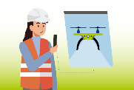




HWC 2023-25 - Safe and healthy work in the digital age
Healthy Workplaces Campain (HWC) 2023-25
“Safe and healthy work in the digital age”
Five priority areas
    Digital platform work (February – May 2024)
    Automation of tasks (June – September 2024)
    Remote and hybrid work (October 2024 – January 2025)
    Worker management through AI/algorithms (February – May 2025)
    Smart digital systems for OSH monitoring (June – September 2025)

Slide 18

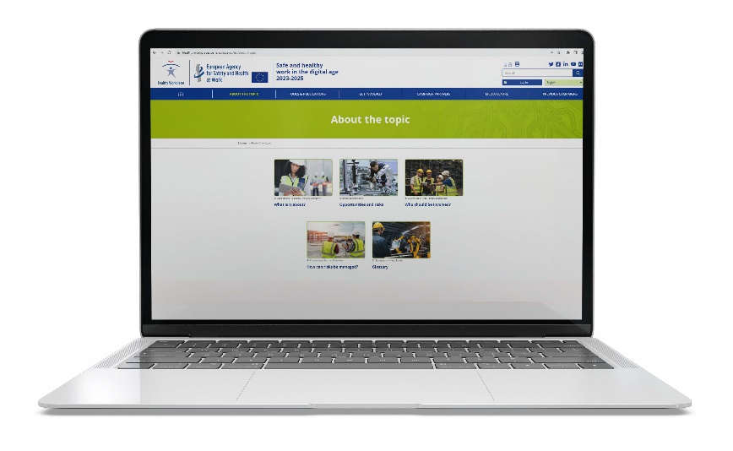

Thank you!
Consult all publications on the topic:
https://osha.europa.eu/en/publications-priority-area/ai-and-worker-management
Healthy Workplaces Campaign “Safe and healthy work in the digital age”:
https://healthy-workplaces.osha.europa.eu/en

Slide 19
Copyright
© European Agency for Safety and Health at Work, 2026
Reproduction is authorised provided the source is acknowledged.
For reproduction or use of any photo under any other copyright than EU-OSHA, permission must be sought directly from the copyright holder.
The images in the ‘promotion milestones’ slides, excluding the HWC visuals, are used under extended license of ‘Adobe Stock’ purchased by EU-OSHA, therefore may not be reproduced in any form.
Neither the European Agency for Safety and Health at Work nor any person acting on behalf of the agency is responsible for the use that might be made of the following information.

