Slide 1
Digital monitoring, algorithmic management and the platformisation of work in the EU
Ignacio González-Vázquez, European Commission – Joint Research Centre
PEROSH Webinar Algorithmic Management and Artificial Intelligence, 27 January 2026

Slide 2
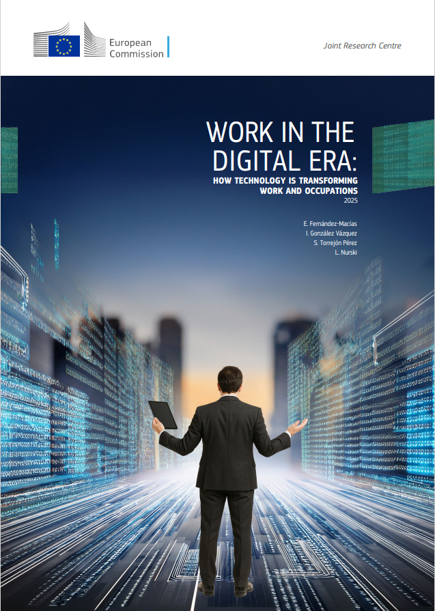
Growing use of data-driven management practices, such as digital monitoring and algorithmic management.
Platformisation of work: use of digital platforms and algorithms as mechanisms of coordination in regular workplaces beyond digital labour platforms.
Platformisation can increase the exposure of workers to psychosocial risk factors.
  Higher work intensity, reduced work autonomy, high cognitive overload, isolation and work-related stress…
  Strong potential for intrusive worker monitoring and surveillance.

Slide 3
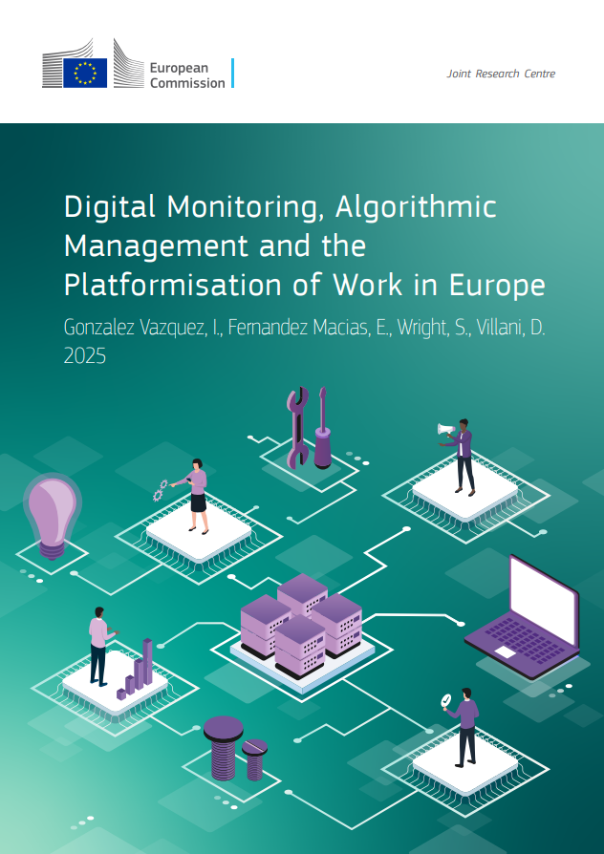
The new AIM-WORK survey
Large pan-European worker survey; responses from 70,316 individuals in all EU member states. Fieldwork in late 2024 – early 2025; CATI methodology.
Measurement of platformisation through three distinct but closely related phenomena:
  Digital tool usage at work, material base for the development of data-driven managerial practices.
  Digital monitoring of work: use of data collected through digital devices about the work process and workers.
  Algorithmic management of work: automation of workforce management and coordination functions.

Slide 4
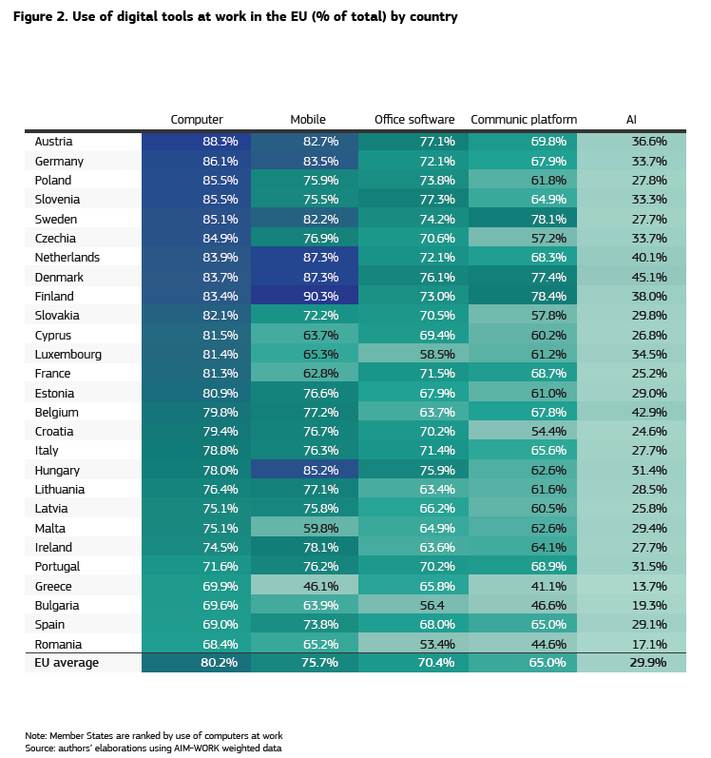
Use of digital tools at work in the EU
More than 90% of workers currently use some digital tool for work-related purposes.
Northern and Central European countries showing higher adoption rates.
While nearly all highly educated workers use digital tools at work, half of those with low education do not use any.
30% of workers have used AI-powered tools for work at least once in the last 12 months. Country variation not very high.

Slide 5
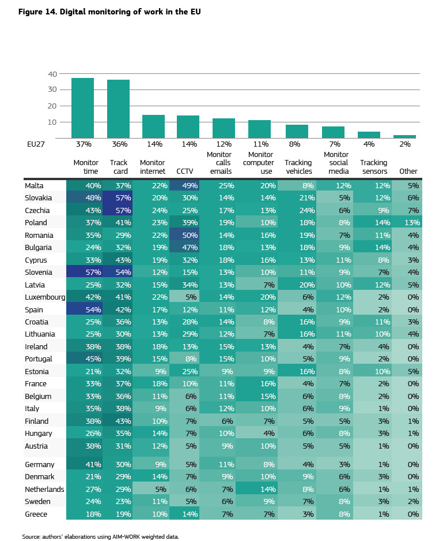
Digital monitoring of work in the EU
    Use of digital tools to systematically collect data about work and workers.
    Three main types:
    Time monitoring: use of digital systems to monitor working time as well as workers’ entry, exit and/or movement.
    Physical monitoring: tracking the physical location of workers.
    Activity monitoring: monitoring of activities carried out with digital tools, typical of office settings.
    Most common type of digital monitoring in the EU is the tracking of working time.
    Other forms of digital monitoring are less common, but more intrusive.

Slide 6
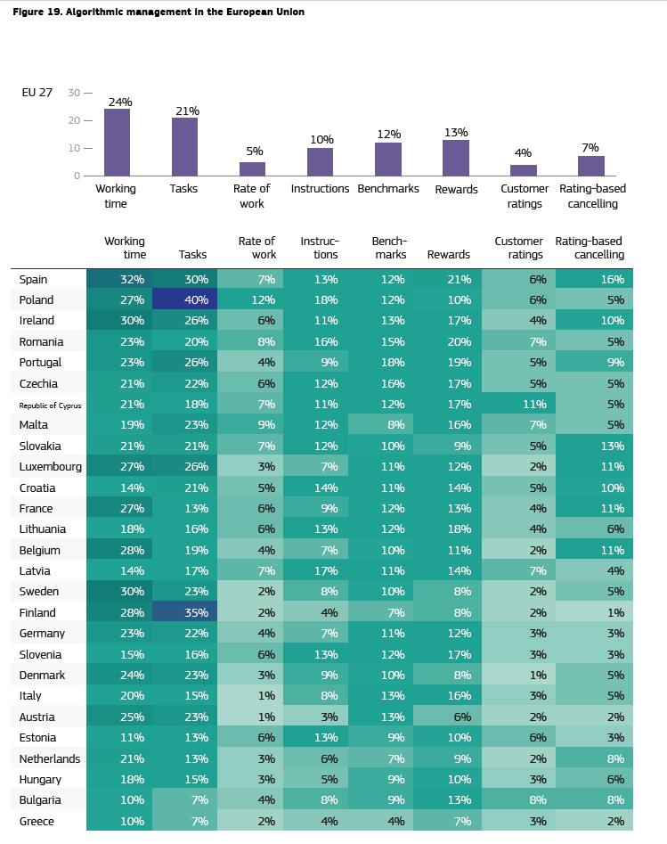
Algorithmic management in the EU
    Use of digital technologies to automate workforce management and coordination functions.
    Two main types :
    Algorithmic direction: use of automated systems to allocate working time and instructions to workers.
    Algorithmic evaluation: systems for automatic rewarding and benchmarking of workers.
    Algorithmic management less common than digital monitoring, although not marginal.
    Automated allocation of work is the most widespread form of algorithmic management, particularly shifts or rosters, followed by the automated allocation of activities/tasks.
    Algorithmic evaluation less prevalent, but not insignificant.

Slide 7
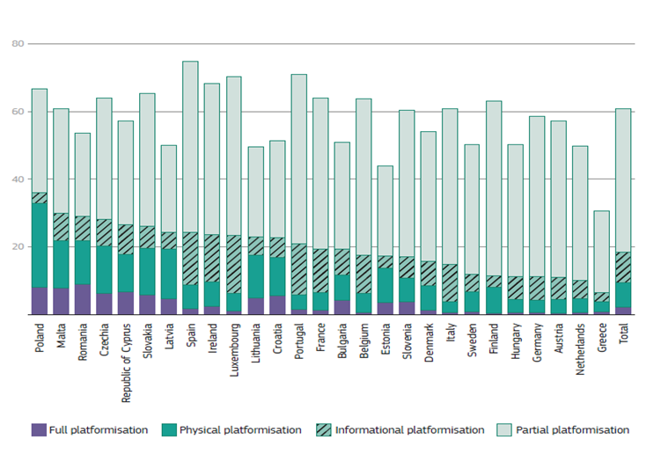
The platformisation of work: a taxonomy of workers
6% of EU workers do not use digital tools.
33% of workers use digital tools but are not platformised.
42% fall under partial platformisation: they are exposed to at least one form of digital monitoring and one form of algorithmic management.
9% of workers experience informational platformisation, combining activity monitoring and algorithmic evaluation. Typical of office work: most frequent in clerks and in finance and professional services.
7% face physical platformisation, combining physical monitoring and algorithmic direction. Typical of manual work activities: common for operators and in sectors such as mining, transportation and logistics.
2% of EU workers are fully platformised. This means that they are simultaneously subject to all forms of digital monitoring and algorithmic management.

Slide 8
Platformisation and job quality
Platformisation types
    Full and physical platformisation are associated with:
    increased stress
    diminished autonomy and flexibility.
    Partial platformisation and “informational platformisation” do not seem to have significantly negative consequences for workers, to the extent covered by AIM-WORK.
    Impacts are context-specific: they differ significantly across sectors, countries and institutional settings.
    Central-Eastern EU Member States consistently display negative associations between some forms of platformisation and job quality…
    …but this is generally not the case in Western-Northern Europan Member States.
Job quality indicators
Source: Mariscal de Gante A., Gonzalez-Vazquez, I., Fernandez-Macias, E. (2026, forthcoming)

Slide 9
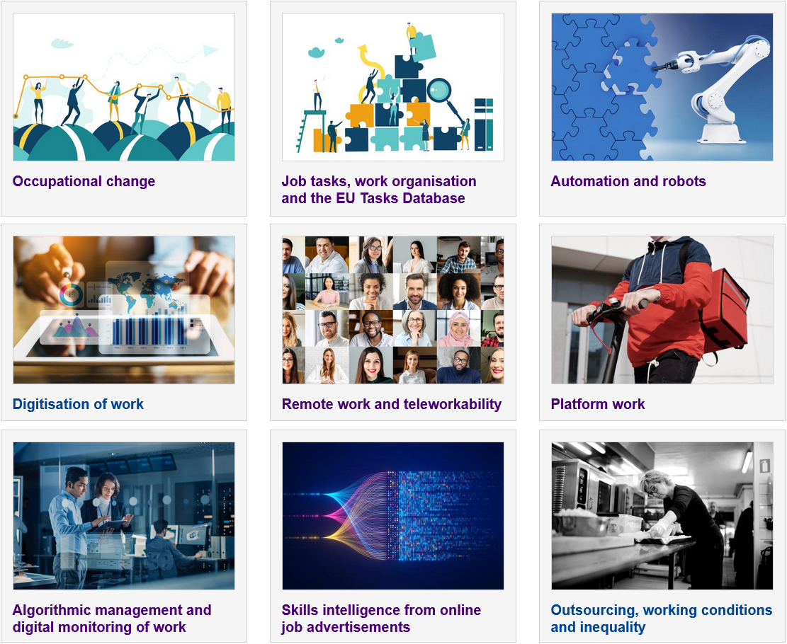


Ignacio.GONZALEZ-VAZQUEZ@ec.europa.eu
europa.eu/!WfCpGH

