Slide 1

ALMA-AI: Exploring OSH impact of Algorithmic Management and AI
Psychosocial factors & OSH based on statistical evidence in regular work
Bowdler, M. (Mairi) | TNO

Slide 2
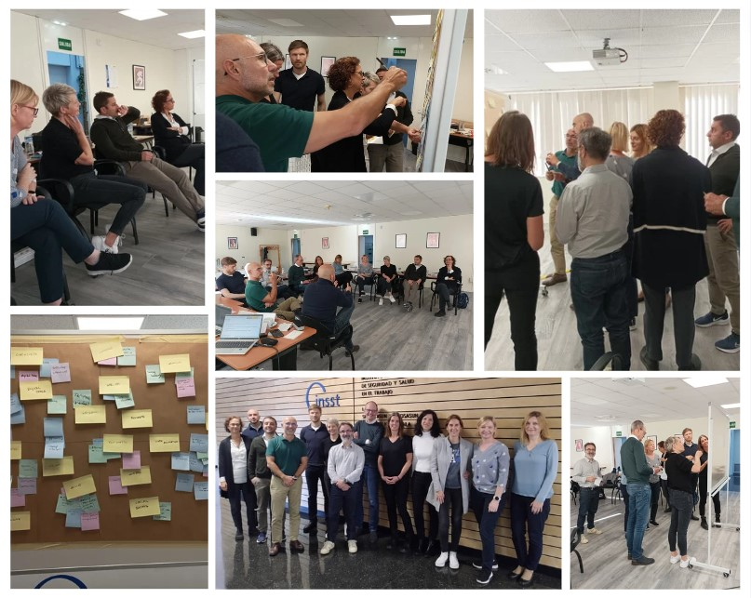
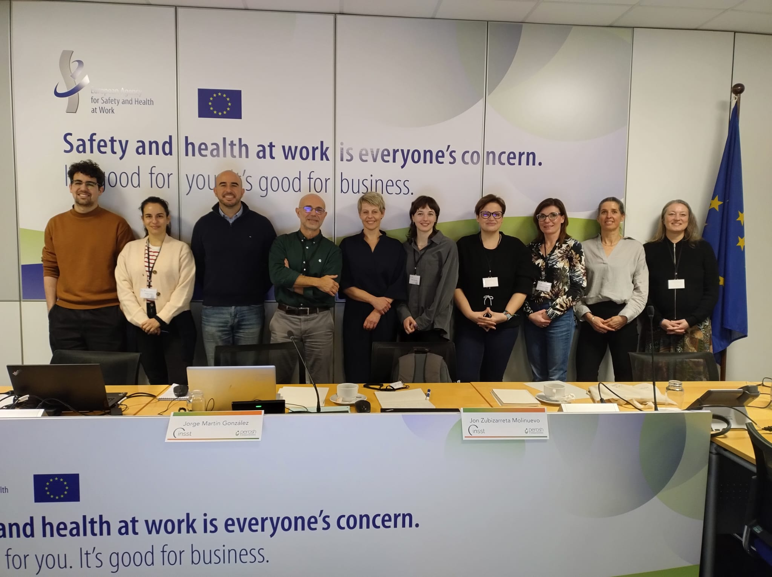

The ALMA-AI Project
2024 – 2026
16+ researchers from 8 institutes:
INSST, Spain (PL)
AUVA, Austria (PL)
CIOP-PIB, Poland
FIOH, Finland
INAIL, Italy
INRS, France
STAMI, Norway
TNO, Netherlands
Advisors:
EU-OSHA
JRC

Slide 3
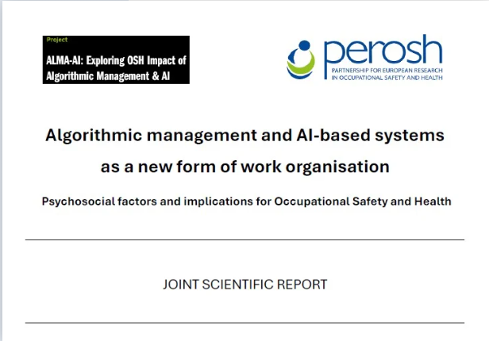

The ALMA-AI Project
The ALMA-AI project seeks to understand algorithmic management’s essence and its implications, in terms of occupational safety and health (OSH) risks and opportunities (incl. psychosocial factors)
“The use of computer-programmed digital systems to (semi) automatically perform management functions that traditionally had been performed by managers or supervisors”
ALMA = algorithmic management
AI = artificial intelligence

Slide 4

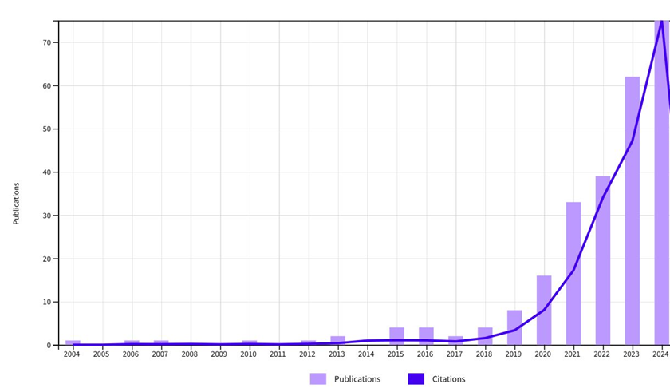

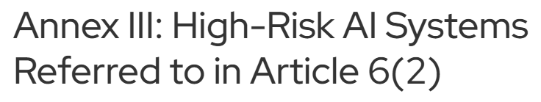
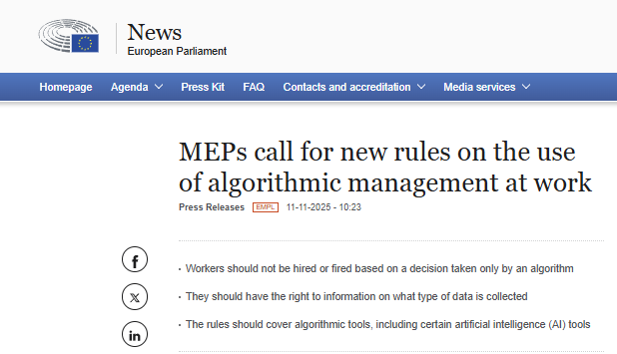
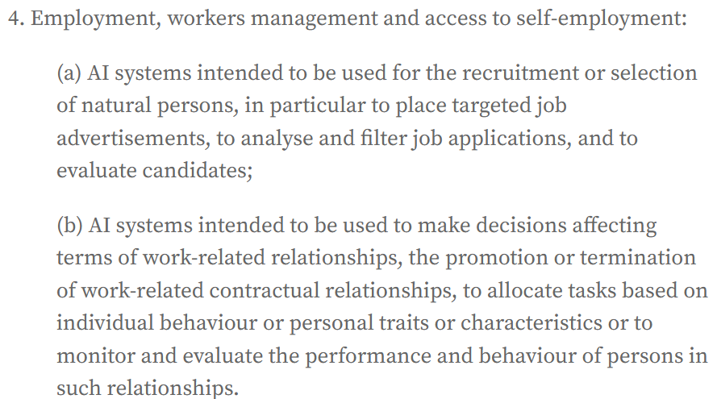
The ALMA-AI Project

Slide 5
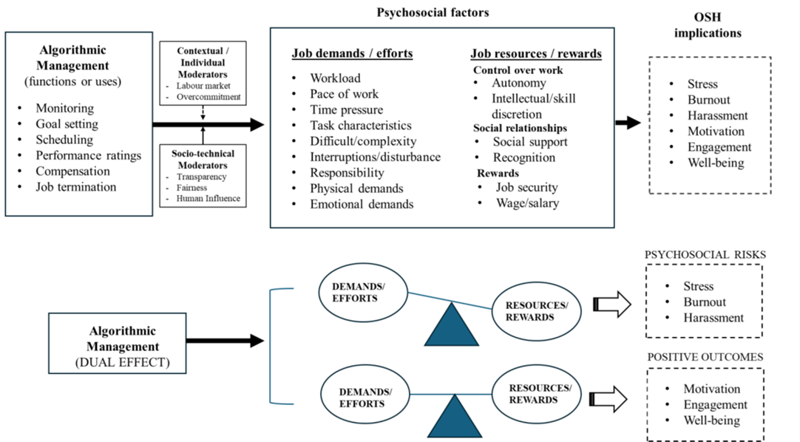
The ALMA-AI Project
ALMA operates as a new form of work
= Risk factors associated with ALMA and OSH most likely have a psychosocial nature
Many theories and models on psychosocial risks and OSH:
Working conditions - the design and organization of work
Social relationships

Slide 6
ALMA-AI Report Methodology
Comprehensive literature review
Web of Science (2022-2024)​: 641 publications ​
Screening criteria: ALMA and OSH focused, direct evidence​
Final report: 39 selected (33 scientific, 6 grey literature) ​
Sectors: logistics hospitality, office work, IT, and more ​

Slide 7
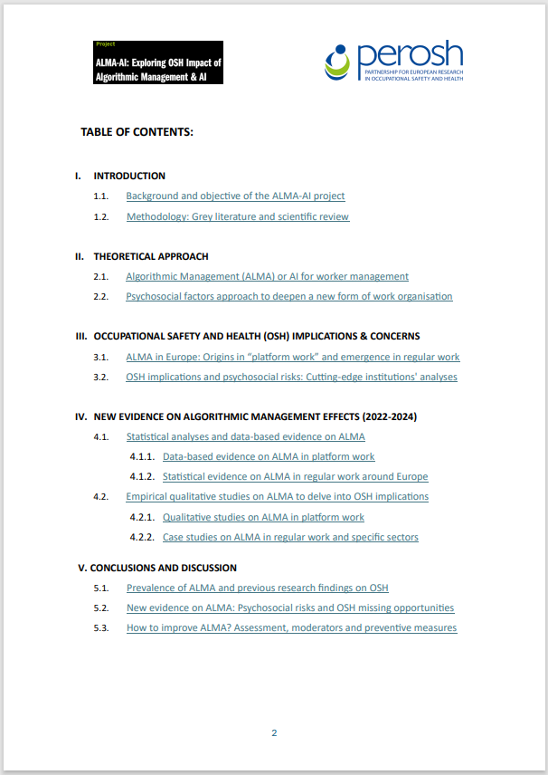
ALMA-AI Report Methodology
Chapter 4.1.2
Statistical evidence on ALMA in regular work
7/33 scientific articles, 2/6 grey literature
‘Regular’ work e.g:
Hospitality
Office workers (e.g. finance)

Slide 8
Key Findings Psychosocial factors & OSH implications
Intensification of Job Demands
Depletion of Job Resources
Moderators of the ALMA impact

Slide 9


Intensification of Job Demands
ALMA tends to intensify job demands.
Employees report more time pressure and stress, especially when digital monitoring is used to track performance or allocate tasks.
Greater risks for clerical and skilled workers (more exposed to automation and detailed monitoring) ​

Slide 10



Depletion of Job Resources
Instead of reinforcing the job resources to deal with work demands…
ALMA reduces them, diminishing the opportunity to boost any positive outcomes
IT service sector
Hospitality
Linked to high employee turnover and discrimination
Employees experiencing:
alienation, loneliness, reduced autonomy, power imbalances, job insecurity, and increased work isolation
Regular workers (across sectors)
Reduced perceived trust and status
Loss of creativity
Limited knowledge combination capability
Hindered goal achievement

Slide 11


Moderators: What can buffer the impact?
Employee Influence: Worker participation in ALMA design and implementation
Transparency: Clear communication about how algorithms work
= reduced ALMA's negative impact on job resources and job demands

Slide 12
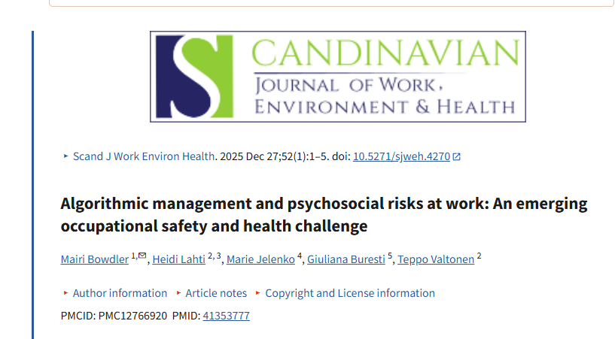
Final Remaks
ALMA is reshaping regular workplaces, often in negative ways:
↑ job demands
↓ key job resources
Make use and continue to examine moderating factors: Participation and transparency
Develop robust, context‑sensitive assessment tools for ALMA practices.
Foster social dialogue, continue research and adapt regulation to balance innovation, productivity, OSH and well-being is crucial as ALMA and AI continue to evolve.​
↑ psychosocial risks
↓ OSH outcomes

Slide 13
Thank you for listening!
Bowdler, M. (Mairi) | TNO
mairi.bowdler@tno.nl

